Slide 1
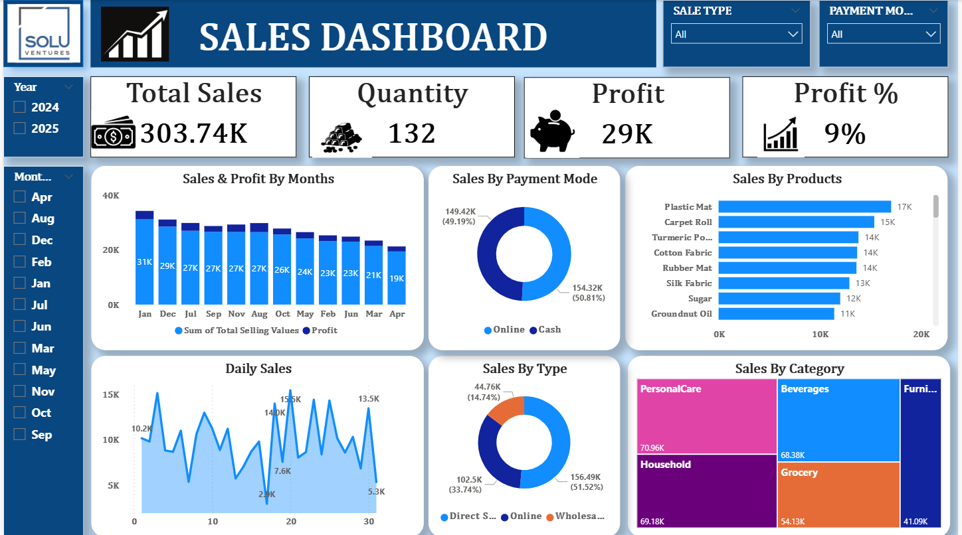
Sales Dashboard
Summary and Explanation
This Sales Dashboard provides an overview of the company's sales performance, profit, quantity sold, payment methods, product performance, and sales categories. It helps management understand business performance and identify opportunities to increase revenue and profitability.

Slide 2
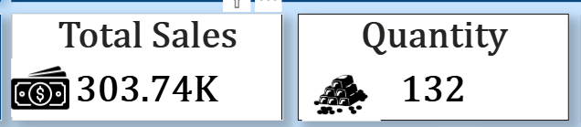
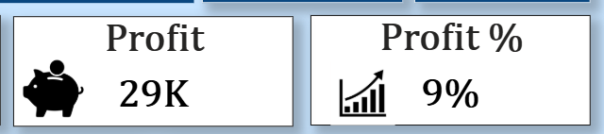
1. Key Performance Indicators (KPIs)
Total Sales
303.74K
Total sales value generated.
Quantity Sold
132
Total quantity sold during the selected period.
Total Profit
29K
Profit earned from sales.
Profit Margin
9%
Reported profit percentage on the dashboard

Slide 3
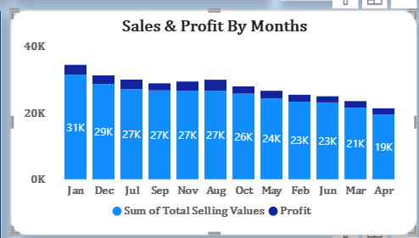
Sales and Profit by Month
Chart: Sales & Profit by Months
January has the highest displayed sales, at approximately 31K.
December follows with around 29K.
July, September, November, and August each show approximately 27K.
April has the lowest displayed monthly sales, at around 19K.
The chart suggests that sales generally decline from the higher-performing months toward April, although the months are not displayed in calendar order.
Insight: January is the strongest month by sales, while April may require additional marketing, promotions, or a review of product demand.

Slide 4
3. Sales by Payment Mode
Online 154.32K
50.81% Online sales
Cash 149.42K
49.19% Cash sales
Insight: Online payments contribute slightly more sales than cash payments. The difference is small, indicating that both payment methods remain important to customers.

Slide 5
Sales by Products
The horizontal bar chart shows the best-performing products by sales value.
Insight: Plastic Mat is the leading product, followed by Carpet Roll. These products could be prioritized for inventory planning and promotional campaigns. Groundnut Oil has the lowest sales among the products displayed.
Product | Sales
Plastic Mat | 17K
Carpet Roll | 15K
Turmeric Powder (label truncated) | 14K
Cotton Fabric | 14K
Rubber Mat | 14K
Silk Fabric | 13K
Sugar | 12K
Groundnut Oil | 11K

Slide 6
Daily Sales Analysis
The daily sales chart shows changes in sales across the days of the selected period.
The highest labeled daily sales value is approximately 15.5K, around day 20.
Other strong days include day 9, at around 12.8K, and day 30, at around 13.5K.
The lowest labeled value is approximately 2.9K, around day 17.
Sales fluctuate significantly, with noticeable peaks and drops throughout the period.
Insight: Sales are not consistent every day. Identifying what happened on high-performing days—such as promotions, customer demand, or bulk orders—could help improve performance on weaker days

Slide 7
Sales by Category
Personal Care
70.96K
Household
69.18K
Beverages
68.38K
Grocery
54.13K
Furniture
41.09K
Insight: Personal Care is the highest-performing category, closely followed by Household and Beverages. Furniture has the lowest sales among the five categories shown.

Slide 8
Filters Available
The dashboard also includes interactive filters to analyze particular parts of the business.
Year: Select 2024 or 2025.
Month: Filter sales by a specific month.
Sale Type: Compare different sales types.
Payment Mode: Compare online and cash payments.
These filters help users investigate sales trends for specific periods and transaction types.

Slide 9
Overall Business Insights and Recommendations
1. Focus on top-performing products Increase availability and consider targeted promotions for Plastic Mat and Carpet Roll.
2. Investigate monthly trends Study why January performs well and identify ways to improve April sales.
3. Maintain payment flexibility Continue supporting both cash and online payments while making digital payments convenient.
4. Improve profitability Review product costs, discounts, and operating expenses to determine how profit margins can be improved.
5. Develop lower-performing categories Investigate Furniture and Grocery sales to identify opportunities for better merchandising and customer targeting.

Slide 10
Conclusion
The dashboard reports 303.74K in total sales, 132 units sold, 29K in profit, and a 9% profit margin. Personal Care is the leading category, Plastic Mat is the top product shown, January is the strongest month, and direct sales are the largest sales channel.
The main priorities should be to improve sales during weaker periods, maintain strong-performing product inventory, grow online and wholesale channels, and investigate ways to improve profitability.
Note: These findings reflect the values visible in the screenshot. The currency, exact reporting period, and calculation behind the 9% profit figure are not specified. It would be worth verifying that the profit percentage is calculated consistently with total sales and profit

